Slide 1



ECOMMERCE DASHBOARD
View in Power BI
Last data refresh:
06/08/2023 14:40:16 UTC
Downloaded at:
06/08/2023 15:36:14 UTC

Slide 2
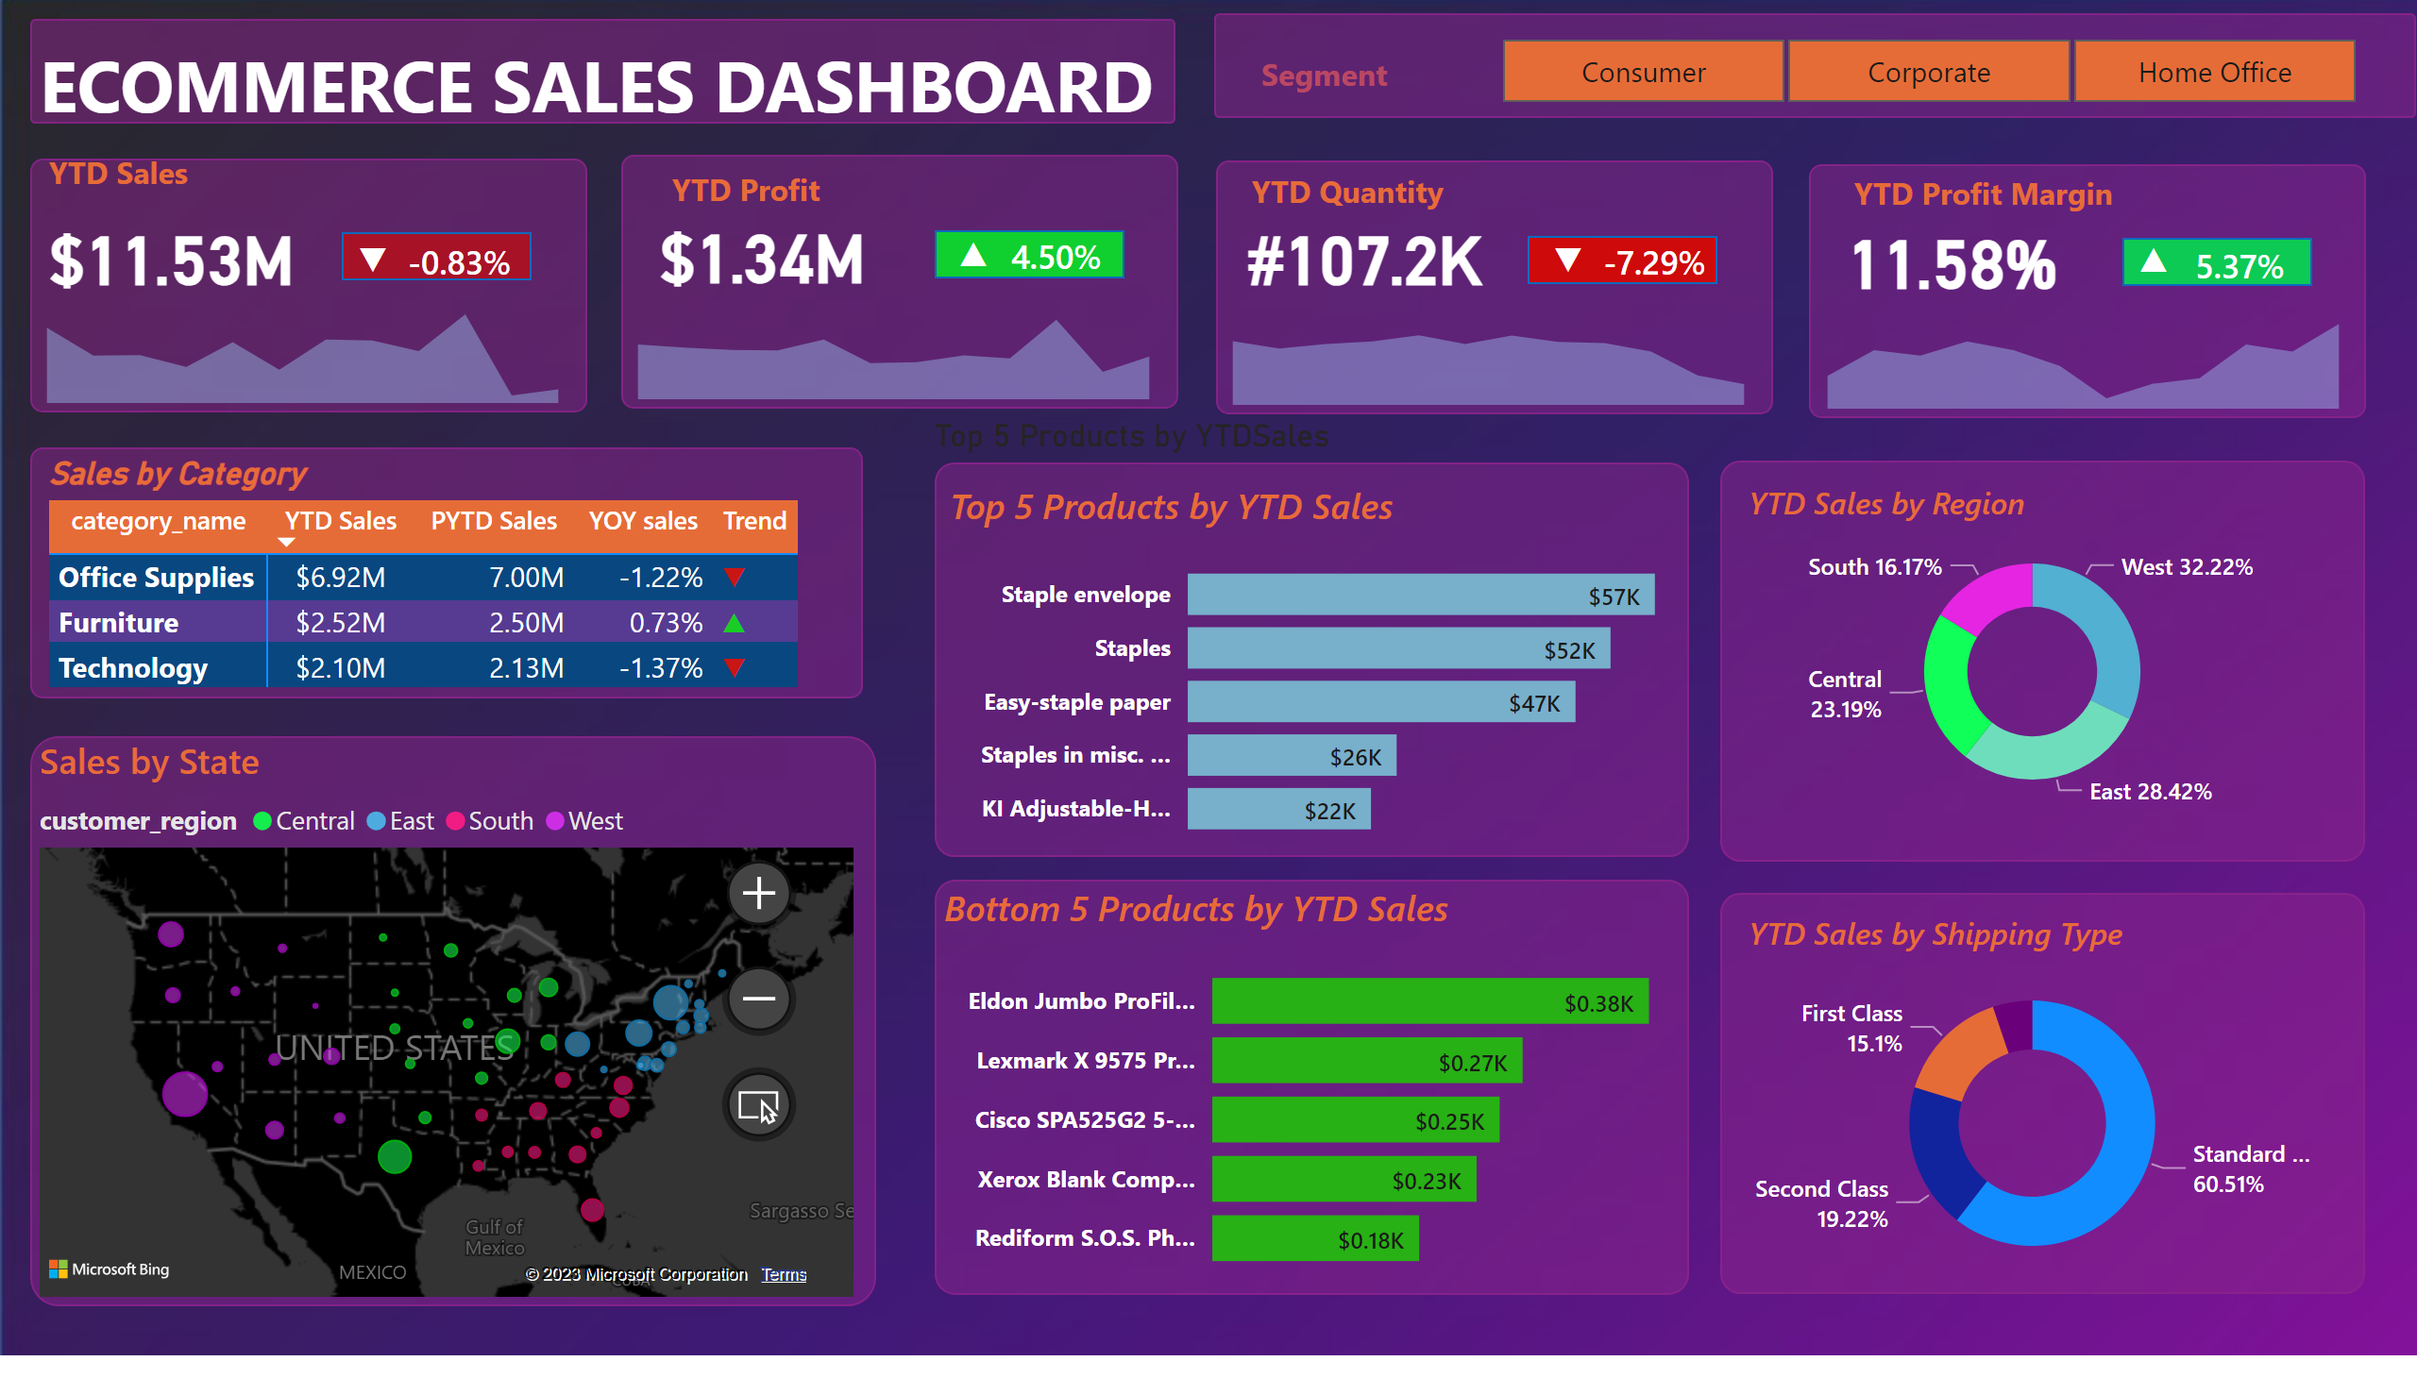
Page 1
Notes:
shape
No alt text provided
textbox
No alt text provided
shape
No alt text provided
card
No alt text provided
areaChart
No alt text provided
card
No alt text provided
shape
No alt text provided
card
No alt text provided
textbox
No alt text provided
shape
No alt text provided
card
No alt text provided
areaChart
No alt text provided
card
No alt text provided
shape
No alt text provided
card
No alt text provided
textbox
No alt text provided
shape
No alt text provided
areaChart
No alt text provided
card
No alt text provided
shape
No alt text provided
card
No alt text provided
textbox
No alt text provided
card
No alt text provided
shape
No alt text provided
areaChart
No alt text provided
card
No alt text provided
shape
No alt text provided
card
No alt text provided
textbox
No alt text provided
card
No alt text provided
shape
No alt text provided
Sales by Category
No alt text provided
shape
No alt text provided
Sales by State
No alt text provided
Top 5 Products by YTDSales
No alt text provided
shape
No alt text provided
Top 5 Products by YTD Sales
No alt text provided
Bottom 5 Products by YTD Sales
No alt text provided
Top 5 Products by YTDSales
No alt text provided
YTD Sales by Region
No alt text provided
Top 5 Products by YTDSales
No alt text provided
YTD Sales by Shipping Type
No alt text provided
shape
No alt text provided
slicer
No alt text provided
textbox
No alt text provided

